Slide 1
GESTURE ASSISTANT
BY
T.M.S.Madhuvani
V.Vineetha Chowdary
P.Shree Shupraja
J.Prathima

Slide 2

CONTENTS
1.INTRODUCTION
2.PROBLEM OF THE PROJECT
3.PROJECT SOLUTION
4.PROCESS

Slide 3
INTRODUCTION
HUMAN COMPUTER INTERACTION.
GESTURE PROVIDES A WAY FOR COMUPTERS TO UNDERSTAND HUMAN BODY LANGUAGE.
GESTURE IS A NON VERBAL COMUNICATION IN WHICH VISIBLE BODY COMMUNICATES PARTICULAR MESSAGE

Slide 4
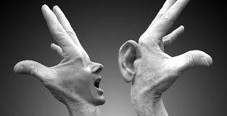
PROBLEM OF THE pROJECT
IN OUR SOCIETY WE HAVE PEOPLE WITH DISIN OUR SOCIETY WE HAVE PEOPLE WITH DI
IN OUR SOCIETY WE HAVE PEOPLE WITH DISABILITIES.
ABOUT NINE BILLION PEOPLE IN THE WORLD ARE DEAF AND DUM.
COMMUNICATION BETWEEN A DEAF MUTE AND A NORMAL PERSON HAVE ALWAYS BEEN A CHALLENGING TASK.
SIGN LANGUAGES USING HAND GESTURES HELPS DEAF AND DUM PEOPLE COMMUNICATE WITH OTHER PEOPLE.

Slide 5
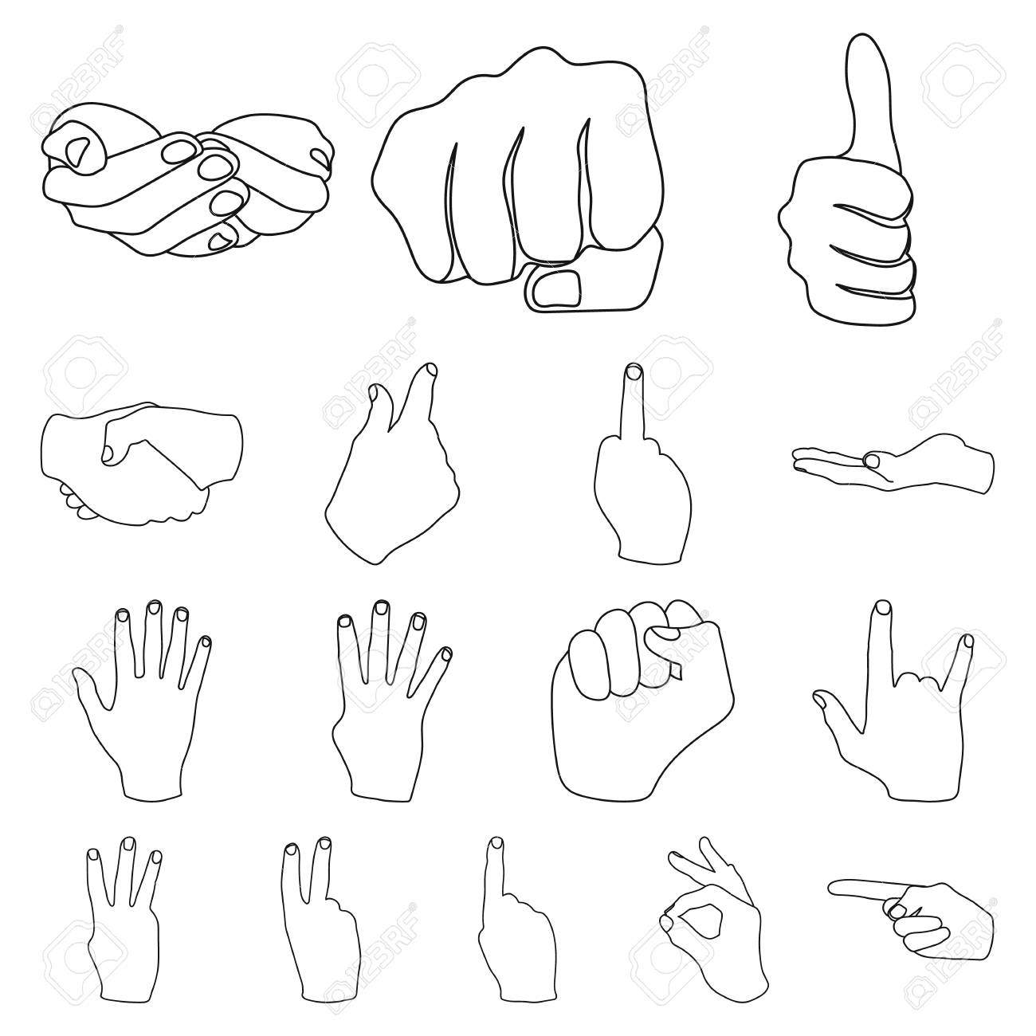
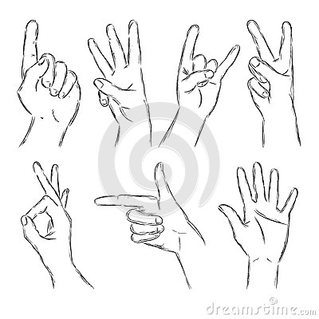
HAND GESTURES
SOME OF THE HAND GESTURES ARE:

Slide 6
PROJECT SOLUTION
GESTURE ASSISTANT IS A WIDELY USED TECHNOLOGY FOR HELPING DEAF AND DUM PEOPLE.
HUMAN HAND HAS REMAINED A POPULAR CHOICE TO CONVEY INFORMATION IN SITUATIONS WHERE SPEECH CANNOT BE USED.
GESTURES ARE CONSIDERED AS MOST NATURAL EXPRESSIVE WAY FOR COMMUNICATION BETWEEN HUMAN AND COMPUTERS.
HAND GESTURESWHICH CAN REPRESENT IDEAS USING UNIQUE SHAPES AND FINGER ORIENTATION HAVE A SCOPE FOR HUMAN MACHINE INTERACTION

Slide 7
PROCESS
FIRST THE DATA IS COLLECTED.
THE DATA IS CLEANED AND SPLIT IS DONE.
CNN MODEL IS BUILD USING NUMPY.
MODELS WITH DIFFERENT PARAMETERS ARE TRAINED .
MODELS ARE COMPARED.
FINALLY THE MODEL WAS TESTED.

Slide 8
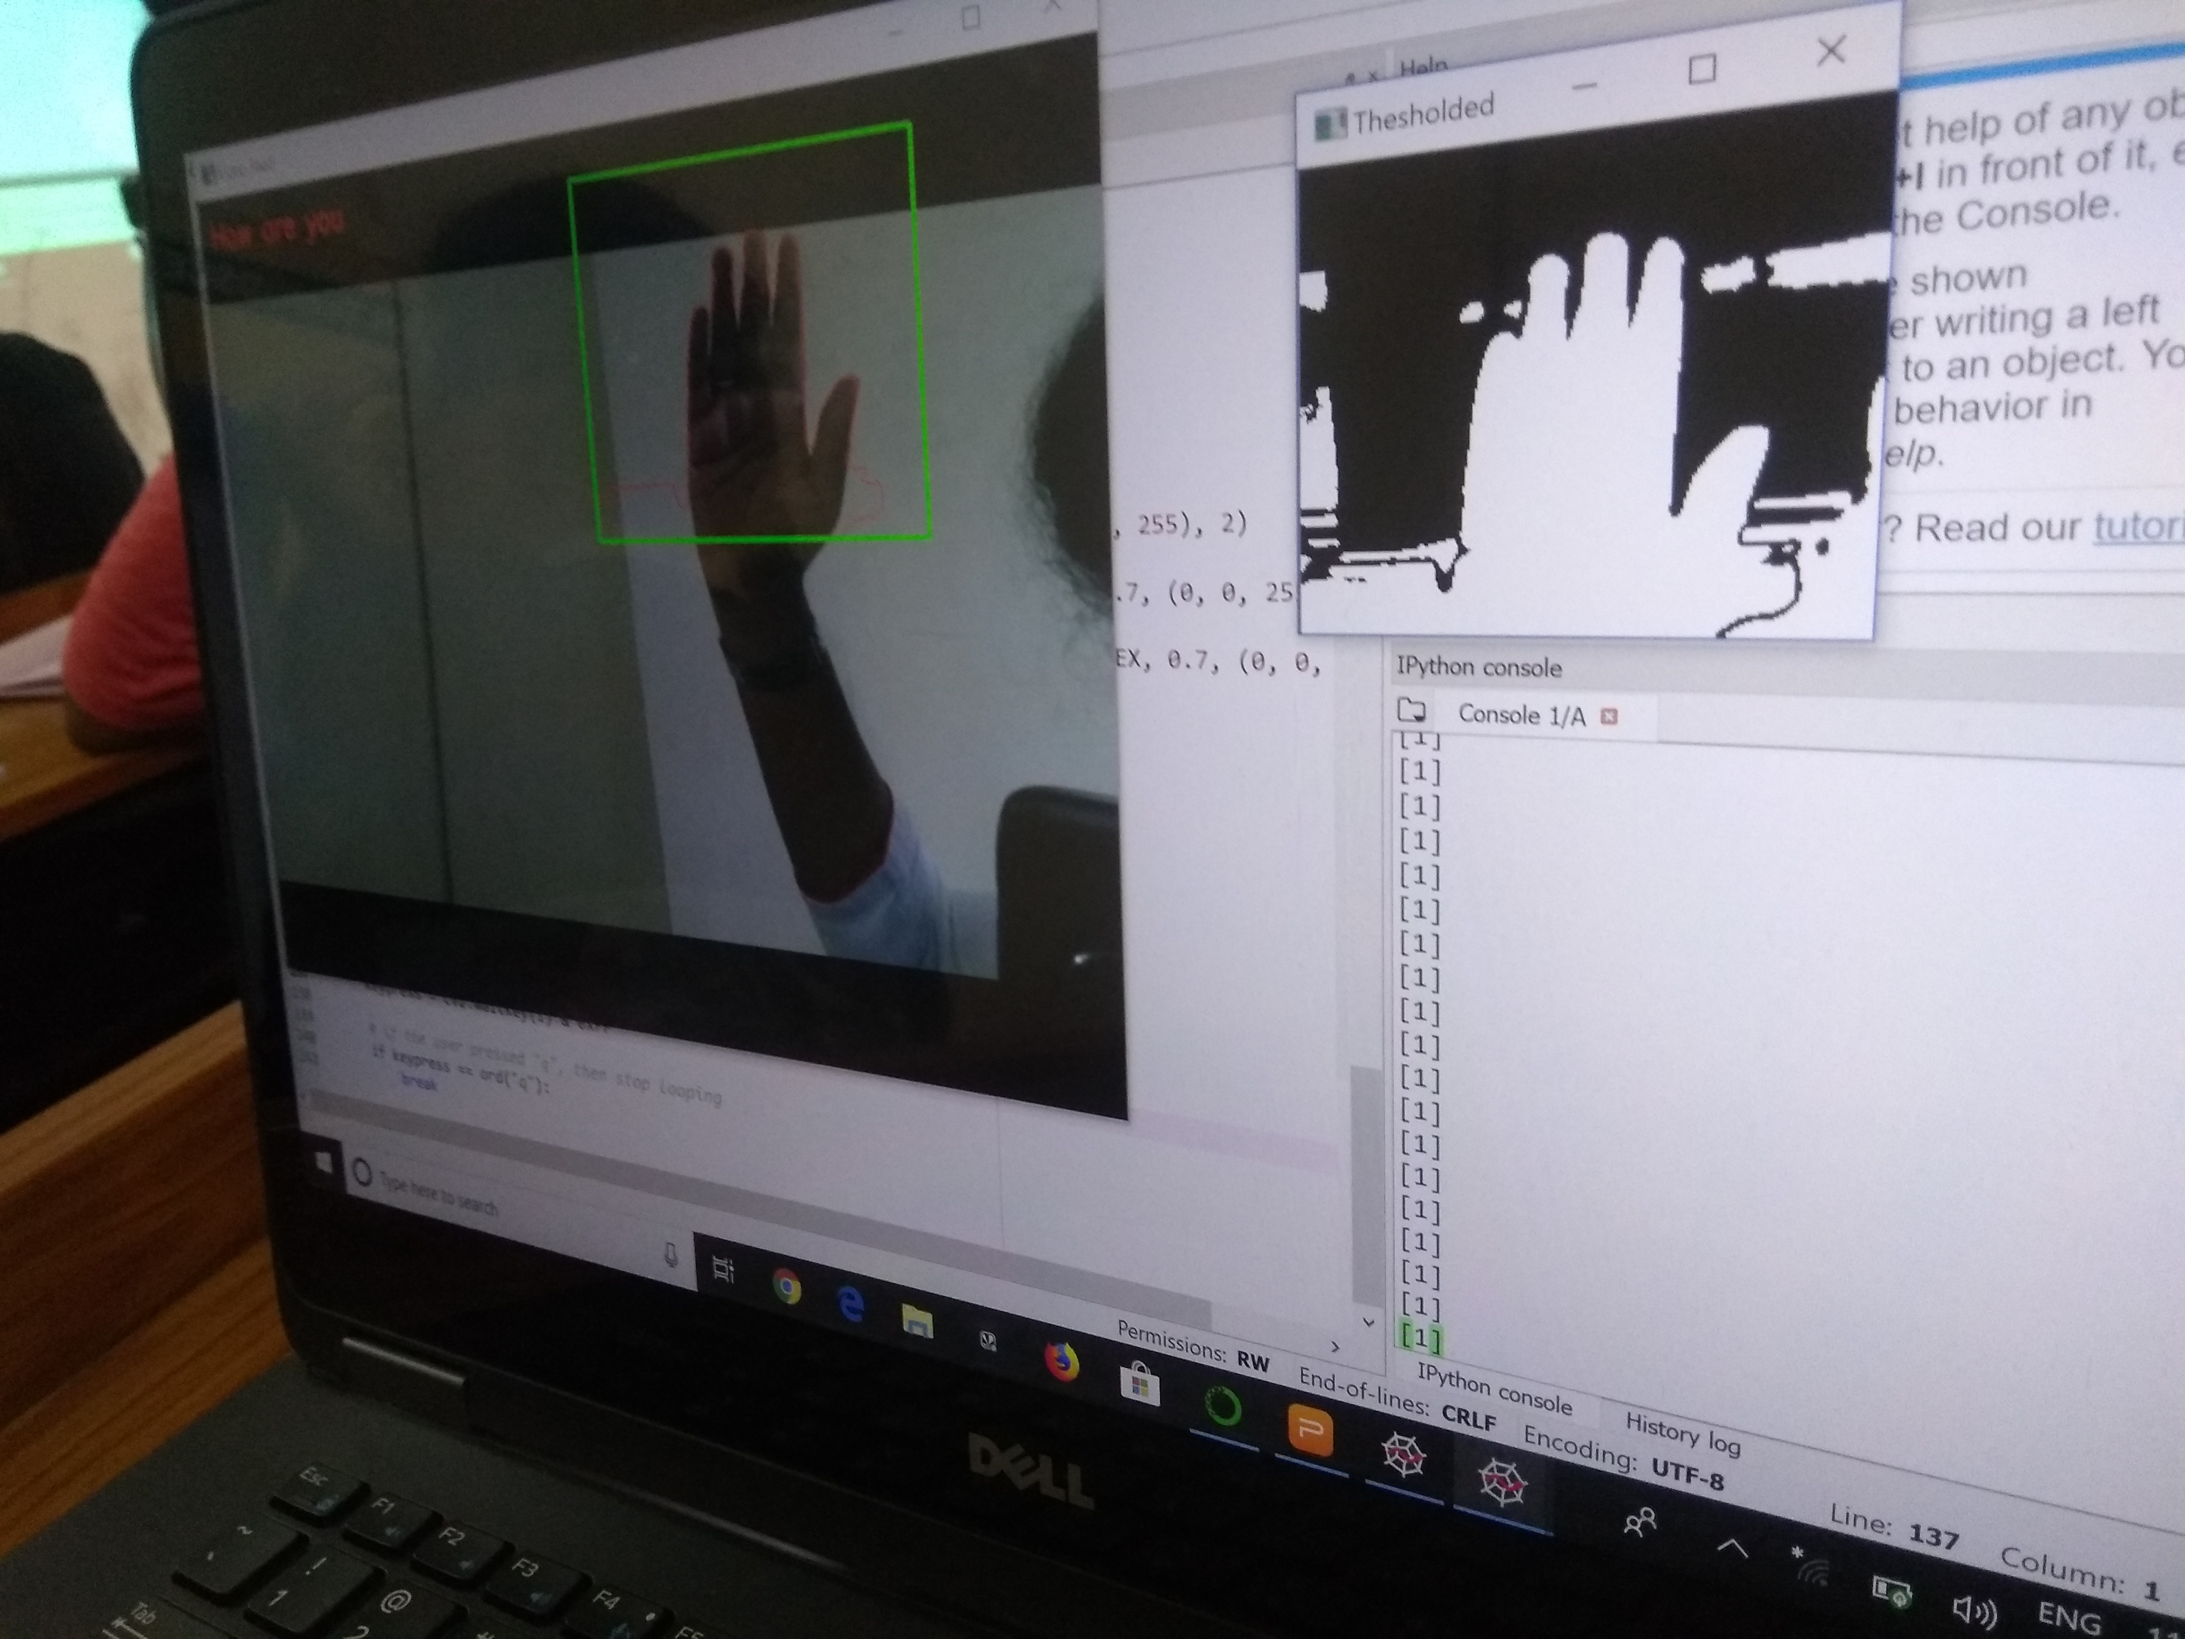
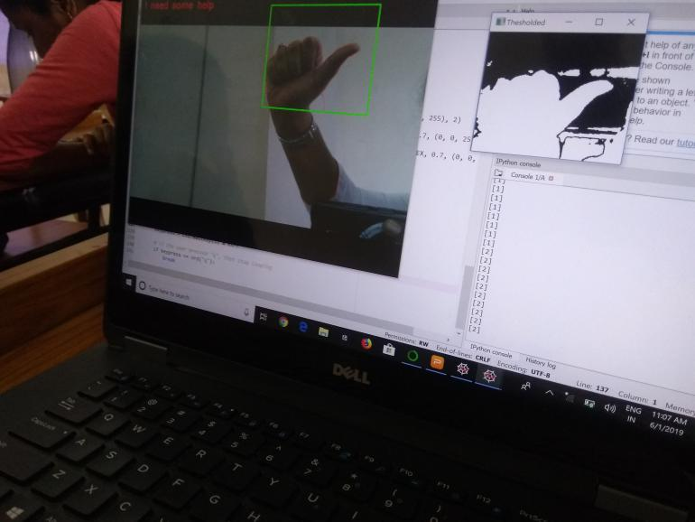
OUTPut

